Slide 1


Automatic Plant Watering System
Presented by:-
Group 6:
Rohitkumar Dulani-71
Sanket Gapat-75
Ali Aslam -79
Deven Nalawade-83
Atharv Parbalkar-100
Pruthviraj Mhasalkar-101
Guide :- Prof. Shital Raut

Slide 2
Automatic Plant Watering System
Problem Statement
Peoples who loves to watering plant but because of their work they do not get that much time daily to spent on that. Again large fields or a farm need lot of water and watering farm time to time is very important or getting good food.
Desired Output
When needed it will automatically water the plant. Check sensor status continuously. Also check Tank status and if empty it will automatically start filling tank.

Slide 3
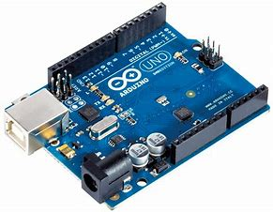
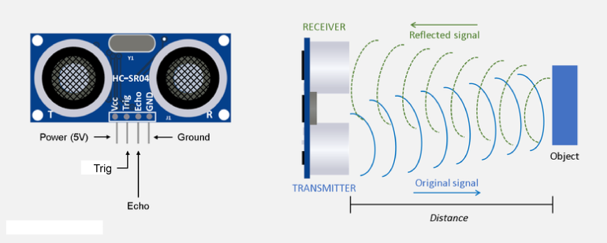
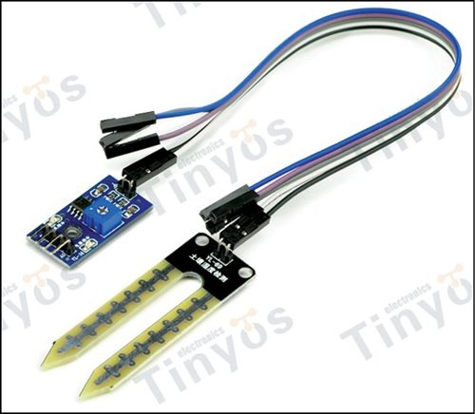
Automatic Plant Watering System
Tools and Technology Used
Soil Moisture Sensor
ARDUINO
Ultrasonic Sensor

Slide 4

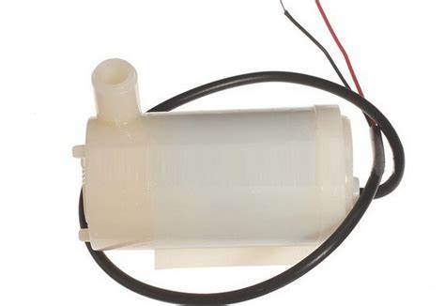
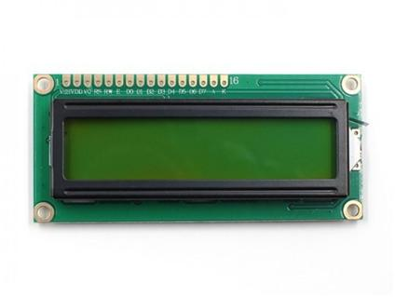
Automatic Plant Watering System
Tools and Technology Used
Lcd display
Water pump
ARDUINO
Ide

Slide 5
Automatic Plant Watering System
Start
Checking Moisture sensor and ultrasonic sensor status
According to status motor pump will turn on or remain off
If Ultrasonic sensor detect high distance then it will turn pump on for filling tank either pump remains off
According to all possibilities Program will Display Data ON LCD display

Slide 6
Automatic Plant Watering System
Benefits
This Project is specially for Plant Lovers
This Project is for farmers
Don’t worry of your gardens. this project will take care of it
Not so big , Not so Expensive, Not so Complicated.
Saves water
Reduce weed development and improve plant development.

Slide 7
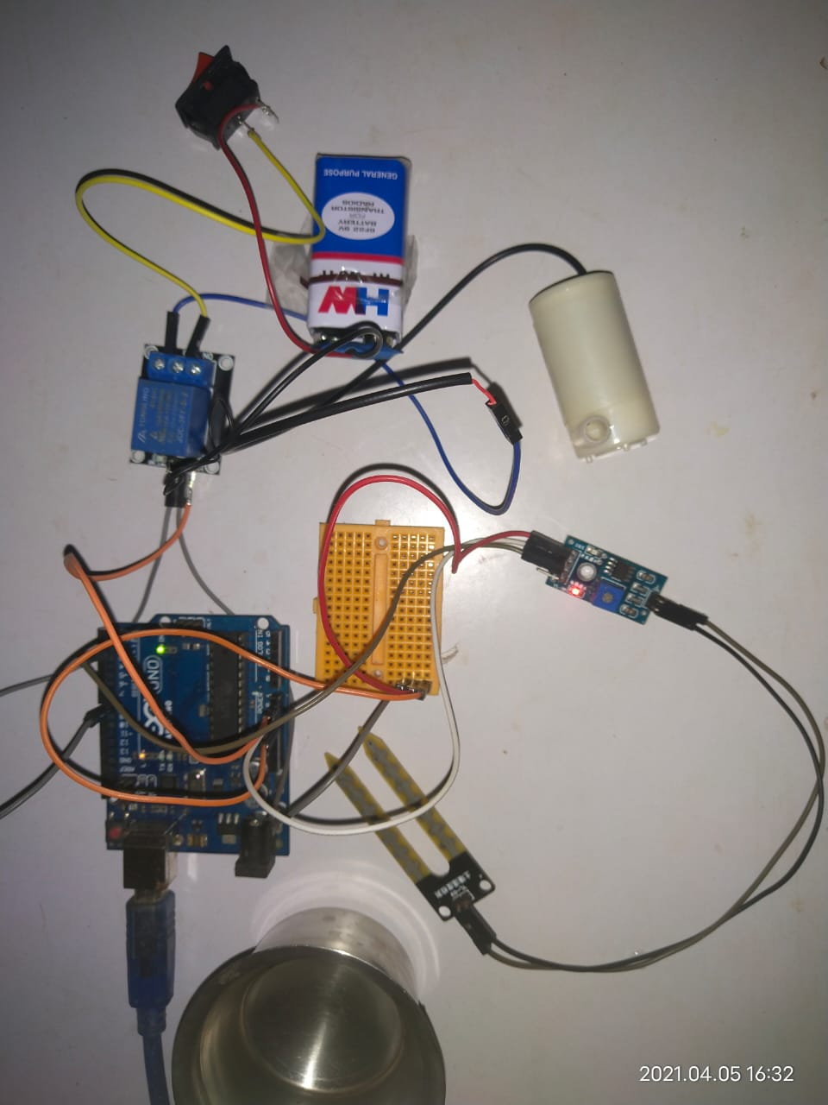
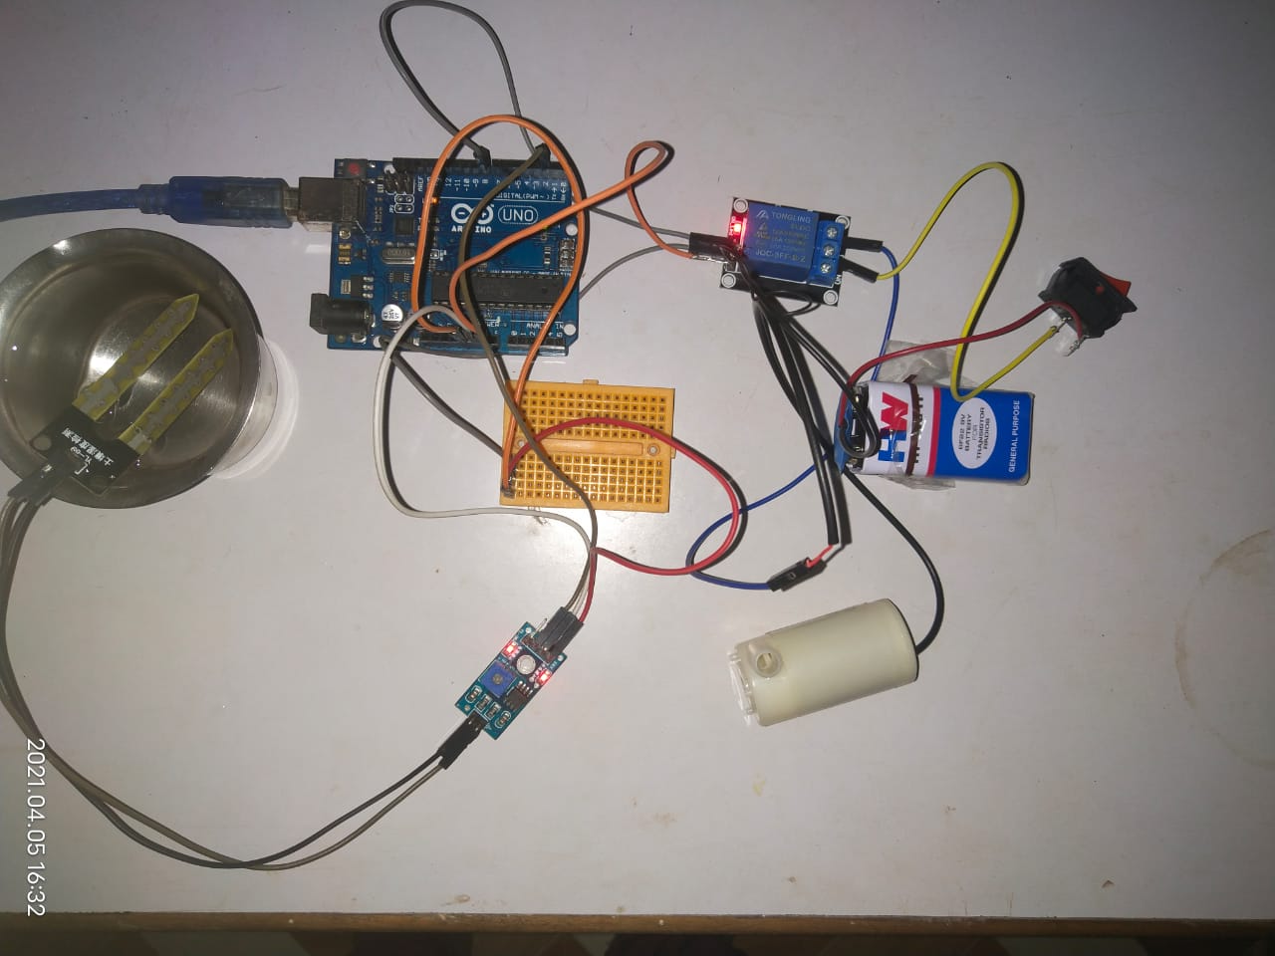
Automatic Plant Watering System
Results
Motor OFF
Motor ON

Slide 8
Automatic Plant Watering System
References
Li Chunfeng and Zhang Xiang, “Design and Study on Hardware Circuit of Agriculture Automatic Microirrigation Control System Based on Single Chip Model AT89S52”, Springer-Verlag Berlin Heidelberg, 2012, page 103-108
Fanghua Li, Bai Wang, Yan Huang, Yun Teng, and TijiuCai, “Study on the Management System of Farmland Intelligent Irrigation”, IFIP International Federation for Information Processing, 2011, page 682-690
Jiachun Li, WenteTu, Jian Fu, and Yongtao Wang, “A Handheld Testing System for Irrigation System Management”, Springer-Verlag Berlin Heidelberg, 2011, page 418-423

